Slide 1

Credit Card Fraud Detection Using Machine Learning.
Under esteemed guidance of Y. Chandana.(M.Tech)
Team Members:-
1) M.KoteswaraRao. (19471A05F7)
2) J.Suryanarayana. (19471A05E9)
3) M.V.Aditya Kumar. (19471A05G8)

Slide 2

Contents :-
Abstract
Literature Survey
Requirements
Key Words
Design Phase
Implementation Phase
Testing Phase
References
Conclusion.

Slide 3
Abstract
This Project is focused on credit card fraud detection in real world scenarios. Nowadays credit card frauds are drastically increasing in number as compared to earlier times. Criminals are using fake identity and various technologies to trap the users and get the money out of them.
Therefore, it is very essential to find a solution to these types of frauds. In this proposed project we designed a model to detect the fraud activity in credit card transactions. This system can provide most of the important features required to detect illegal and illicit transactions. As technology changes constantly, it is becoming difficult to track the behavior and pattern of criminal transactions.
To come up with the solution one can make use of technologies with the increase of machine learning, artificial intelligence and other relevant fields of information technology; it becomes feasible to automate this process and to save some of the intensive amounts of labor that is put into detecting credit card fraud. Initially, we will collect the credit card usage data-set by users and classify it as trained and testing dataset using a random forest algorithm and decision trees.
The performance of the techniques is gauged based on accuracy, sensitivity, and specificity, precision. The results is indicated concerning the best accuracy for Random Forest are unit 98.6% respectively. Keywords— Random forest algorithm, Criminal transactions, Credit card.

Slide 4
Fraudulent Detection in Credit Card System Using SVM & Decision Tree (Vijayshree B. Nipane, Poonam S. Kalinge, Dipali Vidhate, Kunal War, Bhagyashree P. Deshpande):
With growing advancement in the electronic commerce field, fraud is spreading all over the world, causing major financial losses. In the current scenario, Major cause of financial losses is credit card fraud; it not only affects tradesperson but also individual clients.
Random Forest Algorithm, Decision tree, Logistic Regression, K-Nearest Neoghbour, SMOTE are the presented methods used to detect credit card frauds. In contemplating system for fraudulent detection, artificial intelligence concept of Support Vector Machine (SVM) & decision tree is being used to solve the problem. Thus by the implementation of this hybrid approach, financial losses can be reduced to greater extent.
Literature Survey:-

Slide 5
Literature Survey:-
Machine Learning Based Approach to Financial Fraud Detection Process in Mobile Payment System (Dahee Choi and Kyungho Lee):
Mobile payment fraud is the unauthorized use of mobile transaction through identity theft or credit card stealing to fraudulently obtain money. Mobile payment fraud is a fast growing issue through the emergence of smartphone and online transition services. In the real world, a highly accurate process in mobile payment fraud detection is needed since financial fraud causes financial loss.
Therefore, our approach proposed the overall process of detecting mobile payment fraud based on machine learning, supervised and unsupervised method to detect fraud and process large amounts of financial data. Moreover, our approach performed sampling process and feature selection process for fast processing with large volumes of transaction data and to achieve high accuracy in mobile payment detection. F-measure and ROC curve are used to validate our proposed model.

Slide 6
SOFTWARE AND HARDWARE REQUIREMENTS:-
Hardware Requirements:-
• Processor – I3 processor.(minimum)
• Operating System – Windows 7, 8 and 10 (32 and 64 bit)
• Hard Disk – 50 GB or more.
• RAM – 4GB
Software Requirements:-
• Operating System – Windows 7, 8 and 10 (32 and 64 bit)
• Technology: Python, Anaconda.

Slide 7
Key Words or Algorithm:-
Random Forest:-
Random Forest Random forest is a supervised machine learning algorithm based on ensemble learning. Ensemble learning is an algorithm where the predictions are derived by assembling or bagging different models or similar model multiple times. The random forest algorithm works in a similar way and uses multiple algorithm i.e. multiple decision trees, resulting in a forest of trees, hence the name "Random Forest". The random forest algorithm can be used for both regression and classification tasks.

Slide 8
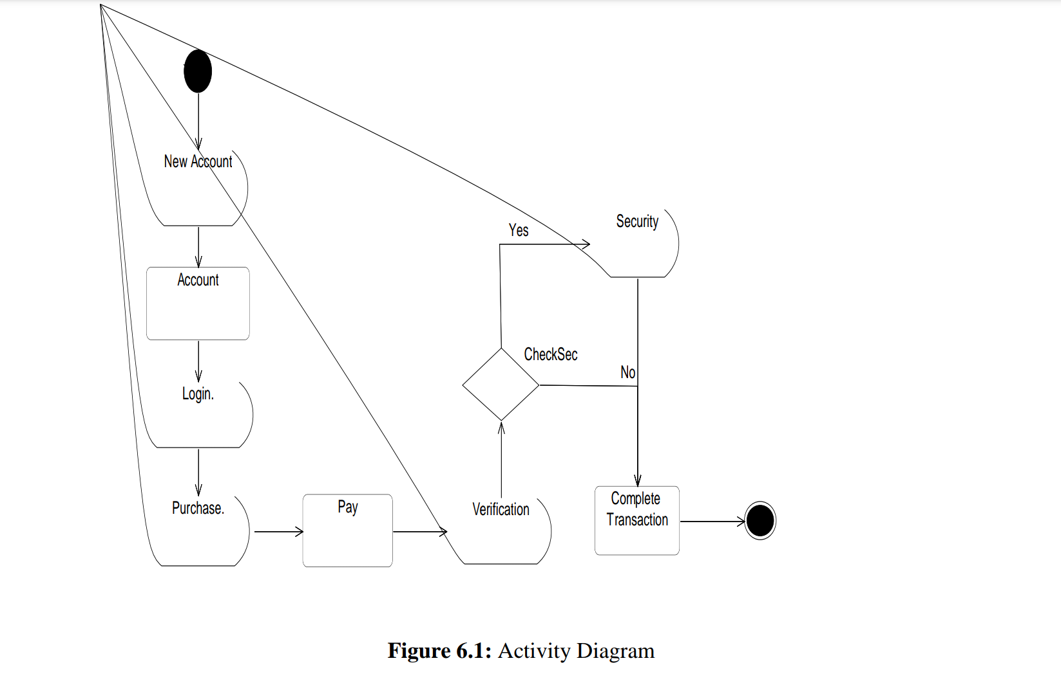
Design Phase:-
Activity Diagram

Slide 9
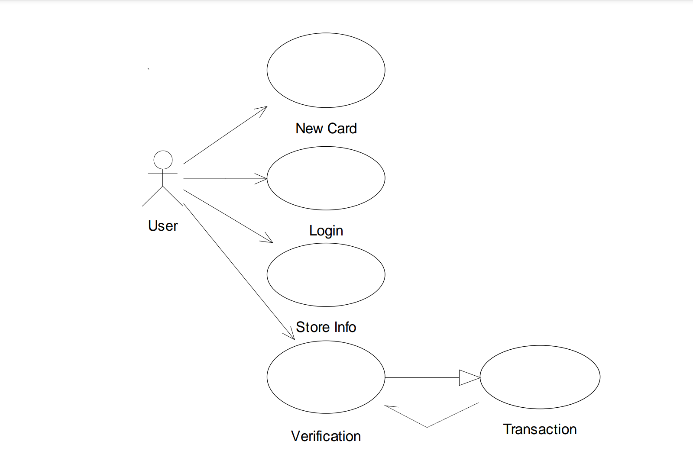
Use Case Diagram

Slide 10
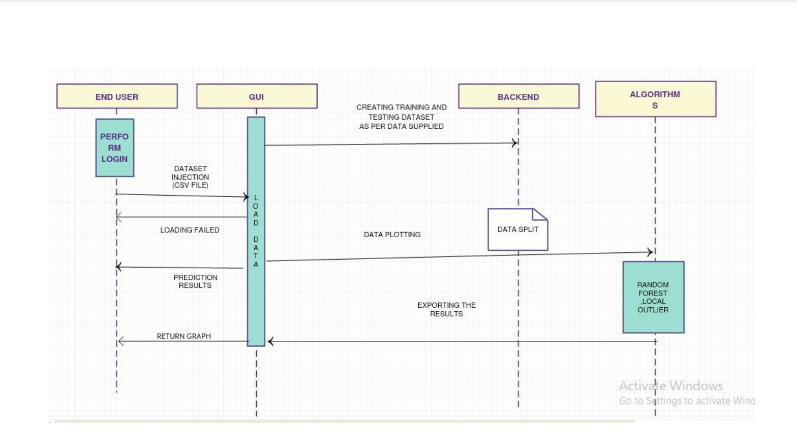
Sequence Diagram

Slide 11
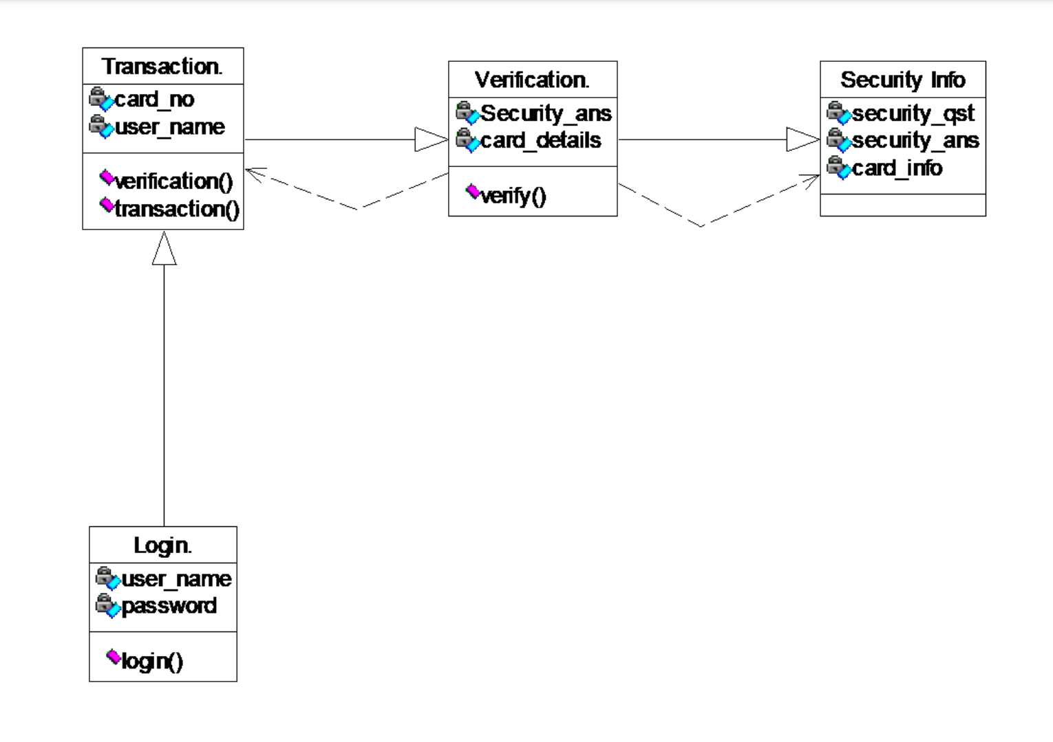
Class Diagram

Slide 12
Implementation:
# Import the necessary modules
import numpy as np
import pandas as pd
import matplotlib.pyplot as plt
from collections import Counter
import itertools
import os
from sklearn.preprocessing import StandardScaler
from sklearn.model_selection import train_test_split
from sklearn.ensemble import RandomForestClassifier
from sklearn.tree import DecisionTreeClassifier
from sklearn.metrics import accuracy_score, precision_score, confusion_matrix, recall_score, f1_score
from google.colab import drive
drive.mount('gdrive')
%cd gdrive

Slide 13
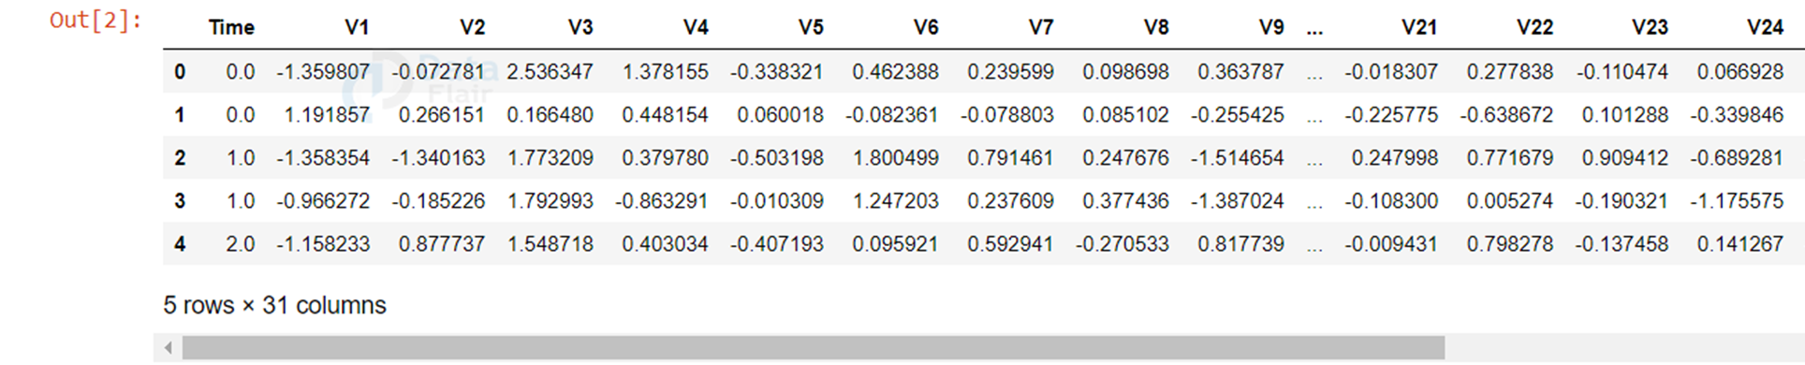
# Load the csv file
dataframe = pd.read_csv("My Drive/1.MKR/creditcard.csv")
dataframe.head()

Slide 14
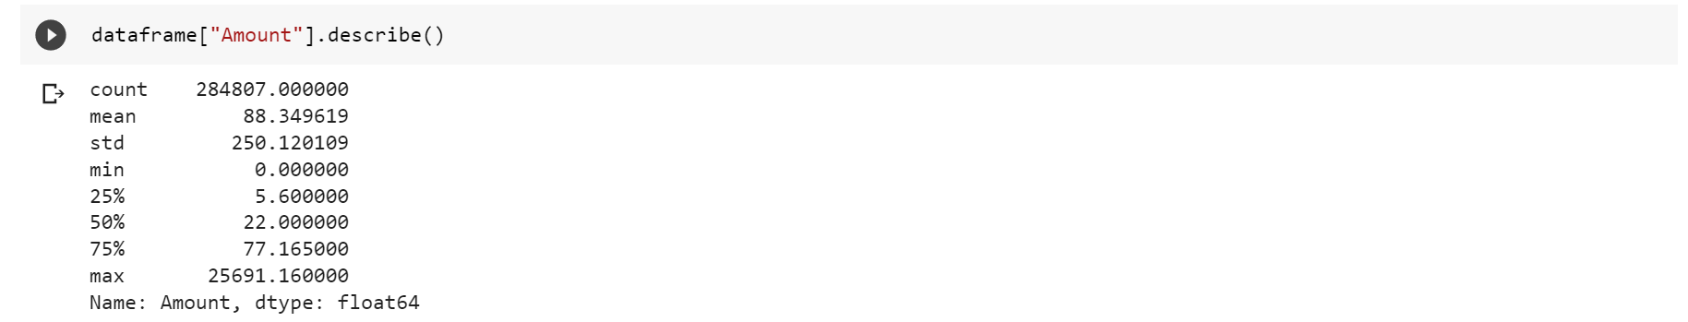
dataframe.isnull().values.any()
OutPut:
False
dataframe["Amount"].describe()
OutPut:

Slide 15
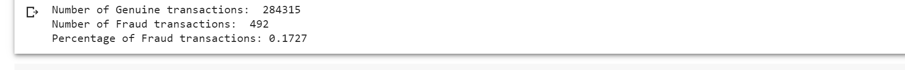
Now, let’s check the number of occurrences of each class label and plot the information using matplotlib.
non_fraud = len(dataframe[dataframe.Class == 0])
fraud = len(dataframe[dataframe.Class == 1])
fraud_percent = (fraud / (fraud + non_fraud)) * 100
print("Number of Genuine transactions: ", non_fraud)
print("Number of Fraud transactions: ", fraud)
print("Percentage of Fraud transactions: {:.4f}".format(fraud_percent))

Slide 16
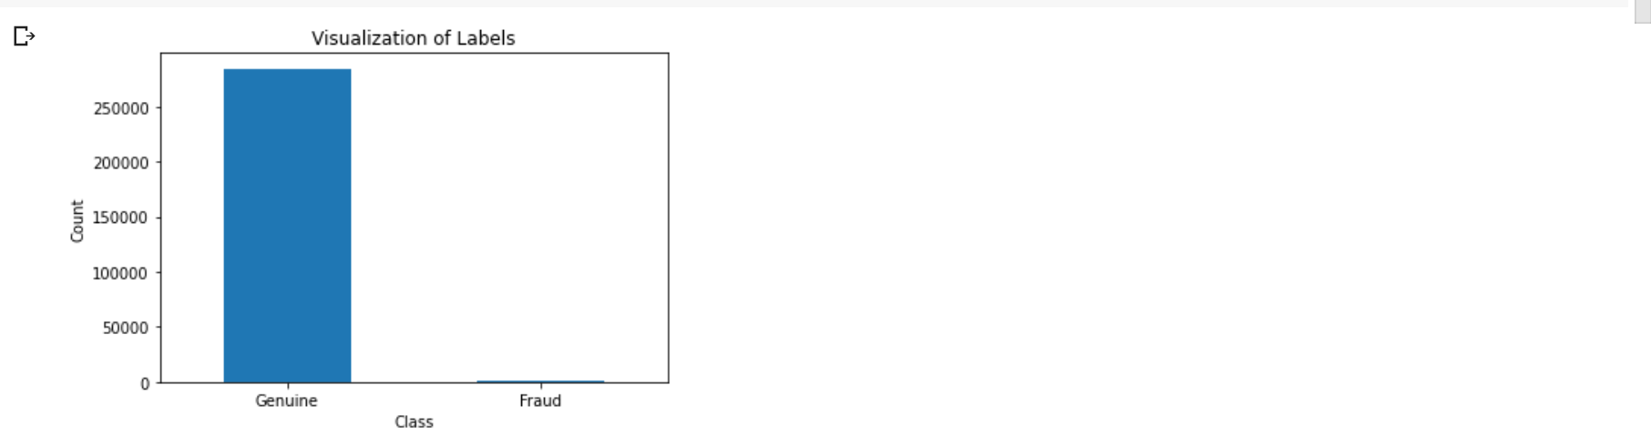
#Visualize the "Labels" column in our dataset
labels = ["Genuine", "Fraud"]
count_classes = dataframe.value_counts(dataframe['Class'], sort= True)
count_classes.plot(kind = "bar", rot = 0)
plt.title("Visualization of Labels")
plt.ylabel("Count")
plt.xticks(range(2), labels)
plt.show()

Slide 17
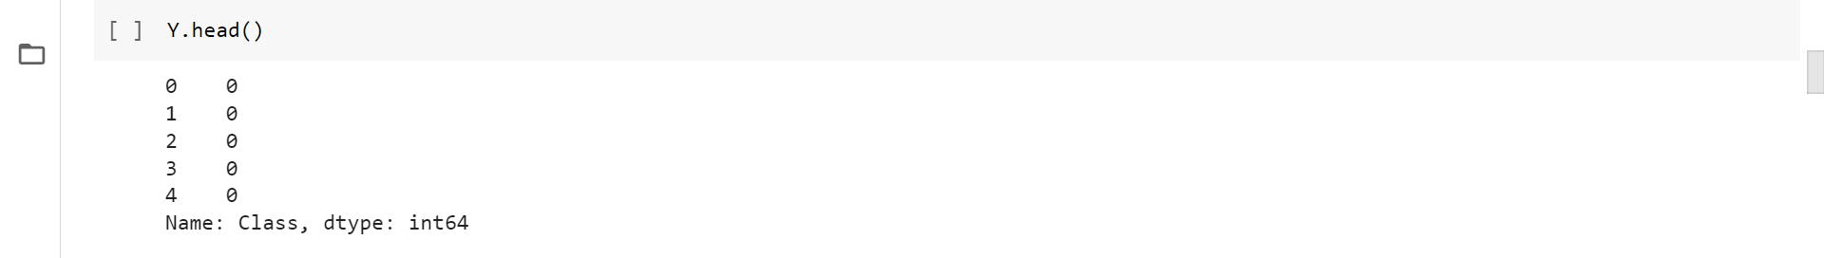
# Perform Scaling
scaler = StandardScaler()
dataframe["NormalizedAmount"] = scaler.fit_transform(dataframe["Amount"].values.reshape(-1, 1))
dataframe.drop(["Amount", "Time"], inplace= True, axis= 1)
Y = dataframe["Class"]
X = dataframe.drop(["Class"], axis= 1)
Y.head()

Slide 18
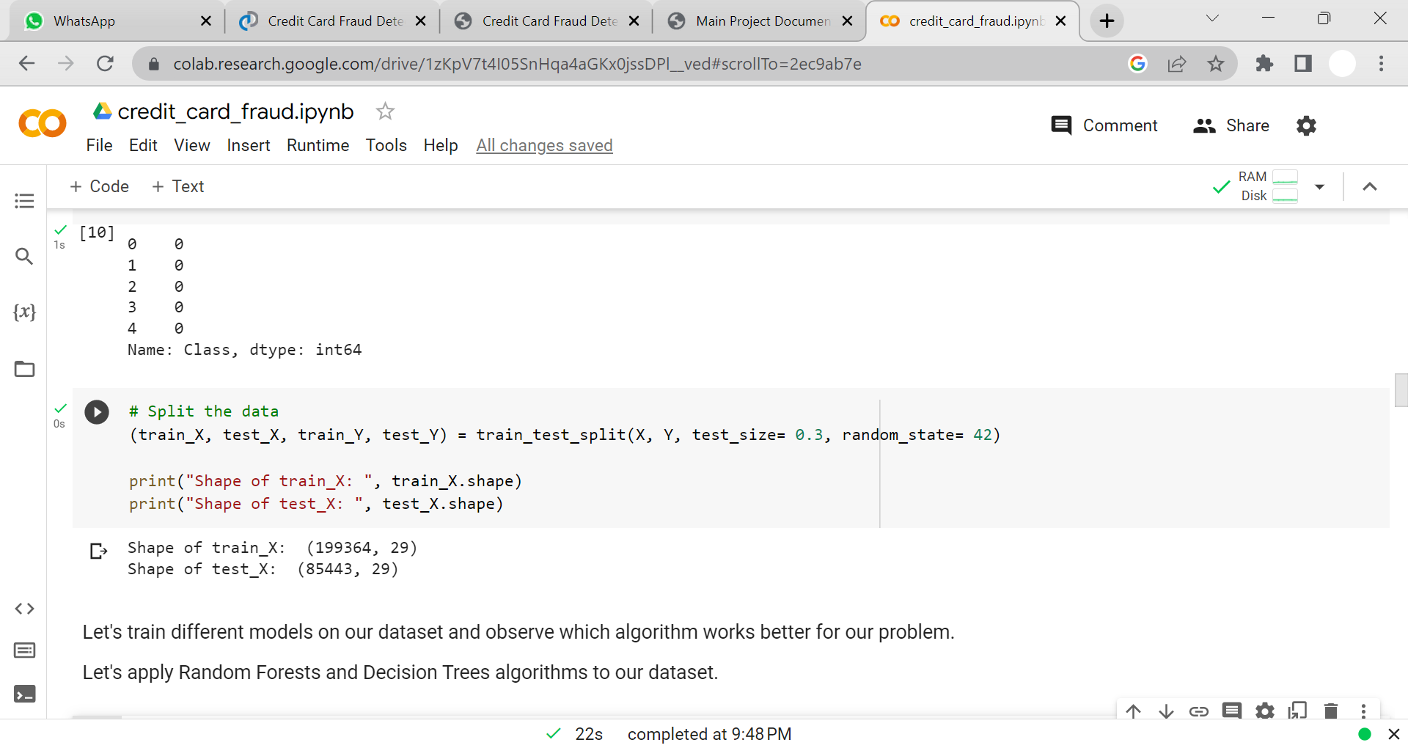
#Split the data
(train_X, test_X, train_Y, test_Y) = train_test_split(X, Y, test_size= 0.3, random_state= 42)
print("Shape of train_X: ", train_X.shape)
print("Shape of test_X: ", test_X.shape)
# Decision Tree Classifier
decision_tree = DecisionTreeClassifier()
decision_tree.fit(train_X, train_Y)
predictions_dt = decision_tree.predict(test_X)
decision_tree_score = decision_tree.score(test_X, test_Y) * 100
# Random Forest
random_forest = RandomForestClassifier(n_estimators= 100)
random_forest.fit(train_X, train_Y)
predictions_rf = random_forest.predict(test_X)
random_forest_score = random_forest.score(test_X, test_Y) * 100

Slide 19
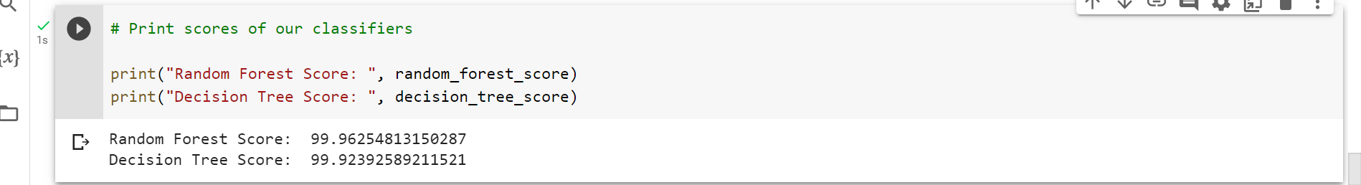
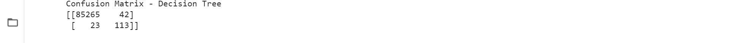
# Print scores of our classifiers
print("Random Forest Score: ", random_forest_score)
print("Decision Tree Score: ", decision_tree_score)
# Plot confusion matrix for Decision Trees
confusion_matrix_dt = confusion_matrix(test_Y, predictions_dt.round())
print("Confusion Matrix - Decision Tree")
print(confusion_matrix_dt)

Slide 20
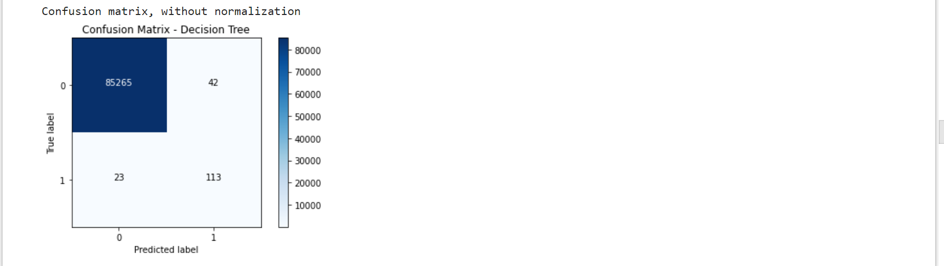
plot_confusion_matrix(confusion_matrix_dt, classes=[0, 1], title= "Confusion Matrix - Decision Tree")
# Plot confusion matrix for Random Forests
confusion_matrix_rf = confusion_matrix(test_Y, predictions_rf.round())
print("Confusion Matrix - Random Forest")
print(confusion_matrix_rf)

Slide 21
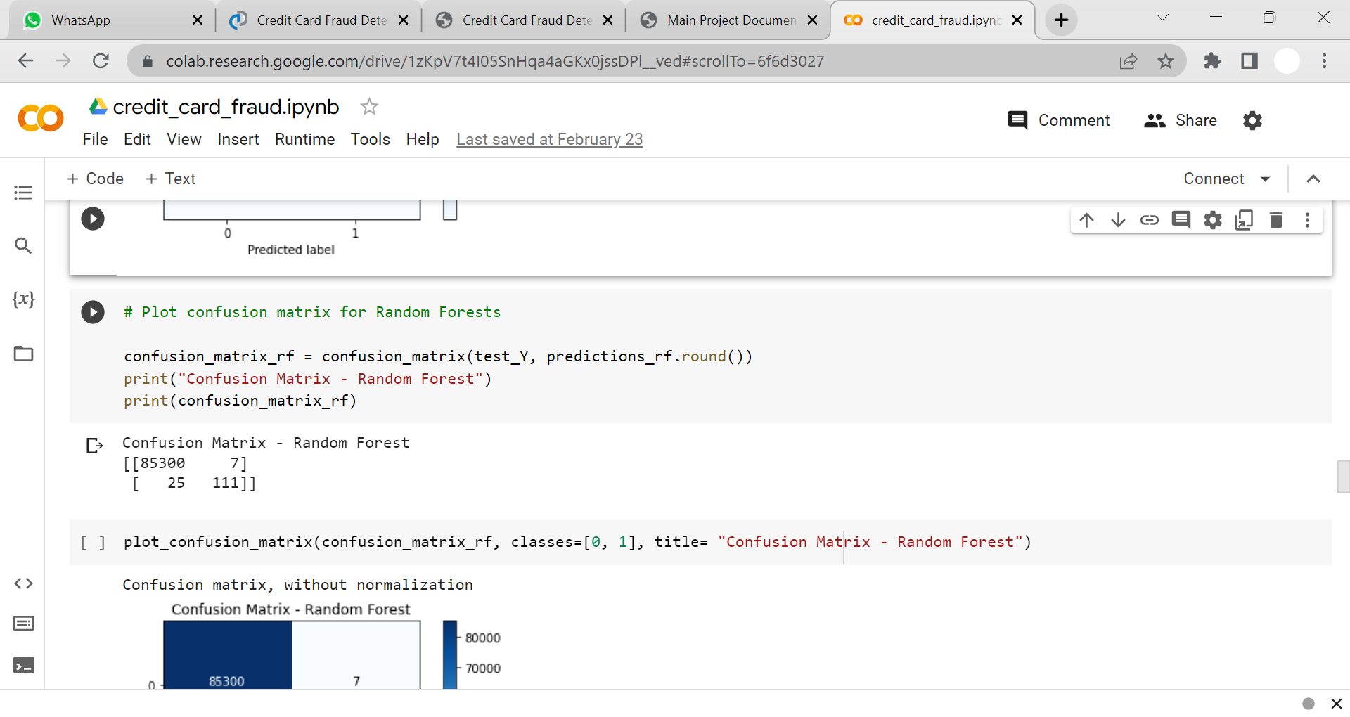

plot_confusion_matrix(confusion_matrix_rf, classes=[0, 1], title= "Confusion Matrix - Random Forest")

Slide 22
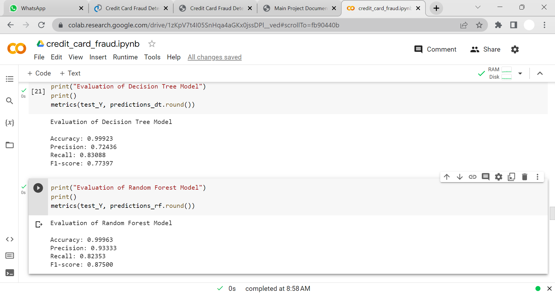
# The below function prints the following necesary metrics
def metrics(actuals, predictions):
print("Accuracy: {:.5f}".format(accuracy_score(actuals, predictions)))
print("Precision: {:.5f}".format(precision_score(actuals, predictions)))
print("Recall: {:.5f}".format(recall_score(actuals, predictions)))
print("F1-score: {:.5f}".format(f1_score(actuals, predictions)))
print("Evaluation of Decision Tree Model")
print()
metrics(test_Y, predictions_dt.round())

Slide 23
print("Evaluation of Random Forest Model")
print()
metrics(test_Y, predictions_rf.round())

Slide 24
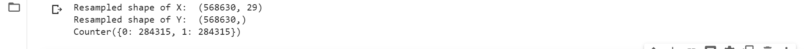
# Performing oversampling on RF and DT
from imblearn.over_sampling import SMOTE
X_resampled, Y_resampled = SMOTE().fit_resample(X, Y)
print("Resampled shape of X: ", X_resampled.shape)
print("Resampled shape of Y: ", Y_resampled.shape)
value_counts = Counter(Y_resampled)
print(value_counts)
(train_X, test_X, train_Y, test_Y) = train_test_split(X_resampled, Y_resampled, test_size= 0.3, random_state= 42)

Slide 25
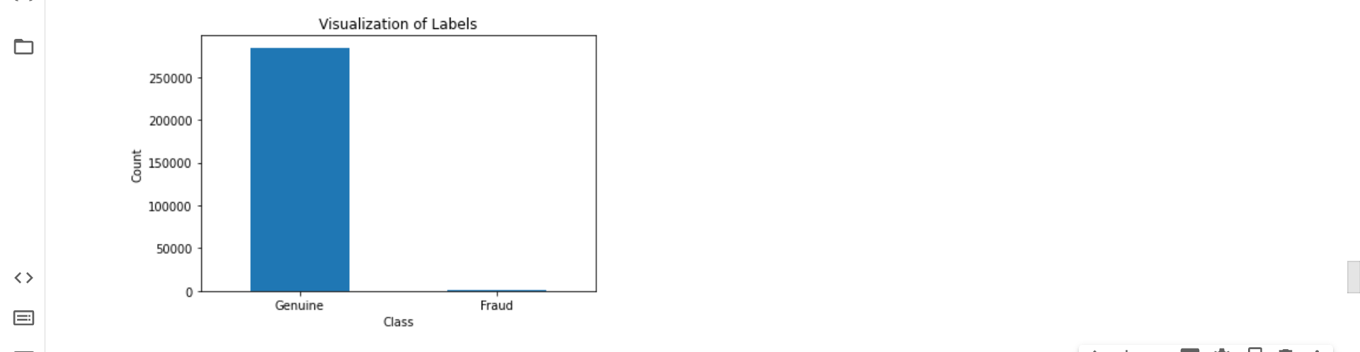
labels = ["Genuine", "Fraud"]
count_classes = dataframe.value_counts(Y_resampled, sort= True)
count_classes.plot(kind = "bar", rot = 0)
plt.title("Visualization of Labels")
plt.ylabel("Count")
plt.xticks(range(2), labels)
plt.show()

Slide 26
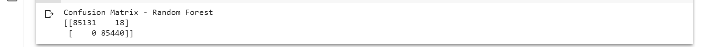
# Build the Random Forest classifier on the new dataset
rf_resampled = RandomForestClassifier(n_estimators = 100)
rf_resampled.fit(train_X, train_Y)
predictions_resampled = rf_resampled.predict(test_X)
random_forest_score_resampled = rf_resampled.score(test_X, test_Y) * 100
# Visualize the confusion matrix
cm_resampled = confusion_matrix(test_Y, predictions_resampled.round())
print("Confusion Matrix - Random Forest")
print(cm_resampled)

Slide 27
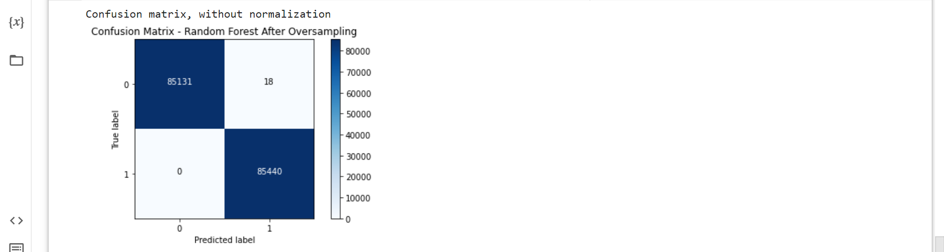
plot_confusion_matrix(cm_resampled, classes=[0, 1], title= "Confusion Matrix - Random Forest After Oversampling")

Slide 28
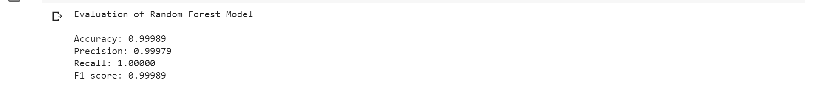
print("Evaluation of Random Forest Model")
print()
metrics(test_Y, predictions_resampled.round())

Slide 29
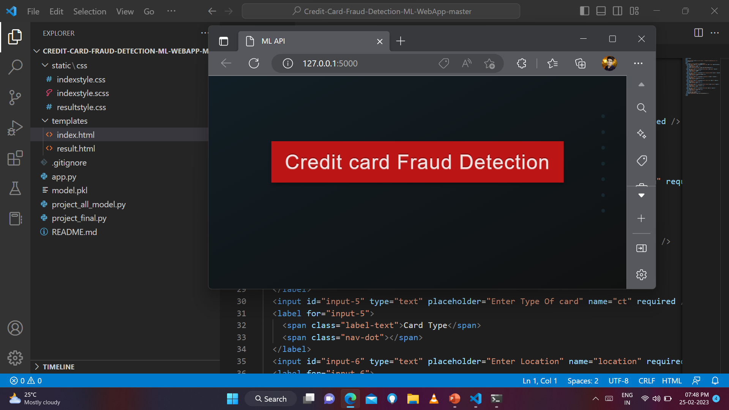
Testing Phase:

Slide 30
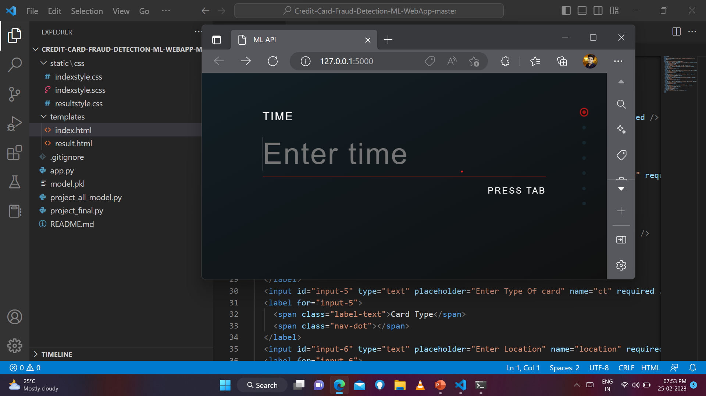

Slide 31
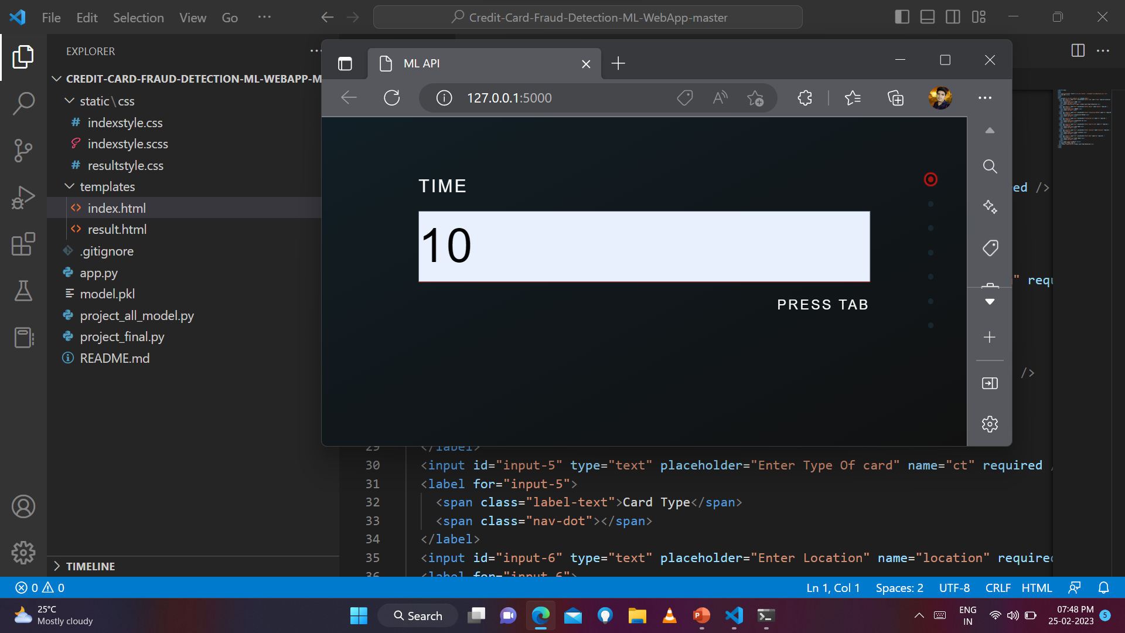

Slide 32


Slide 33
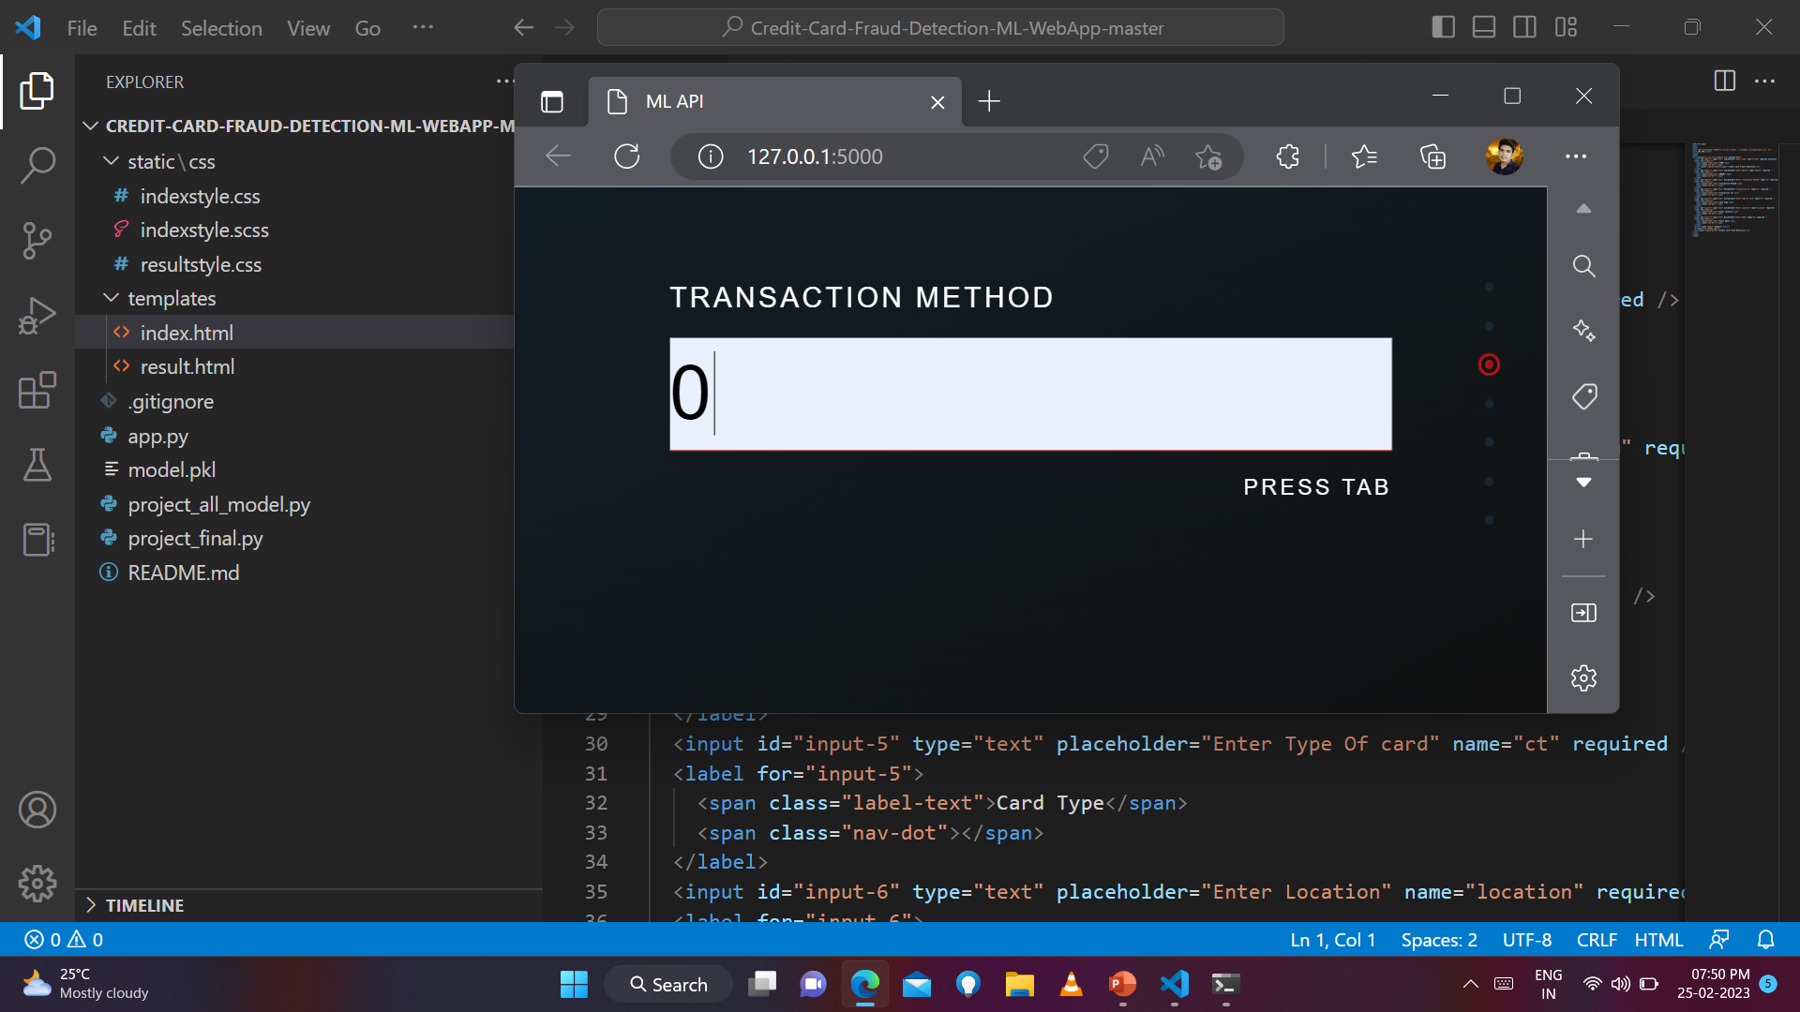

Slide 34
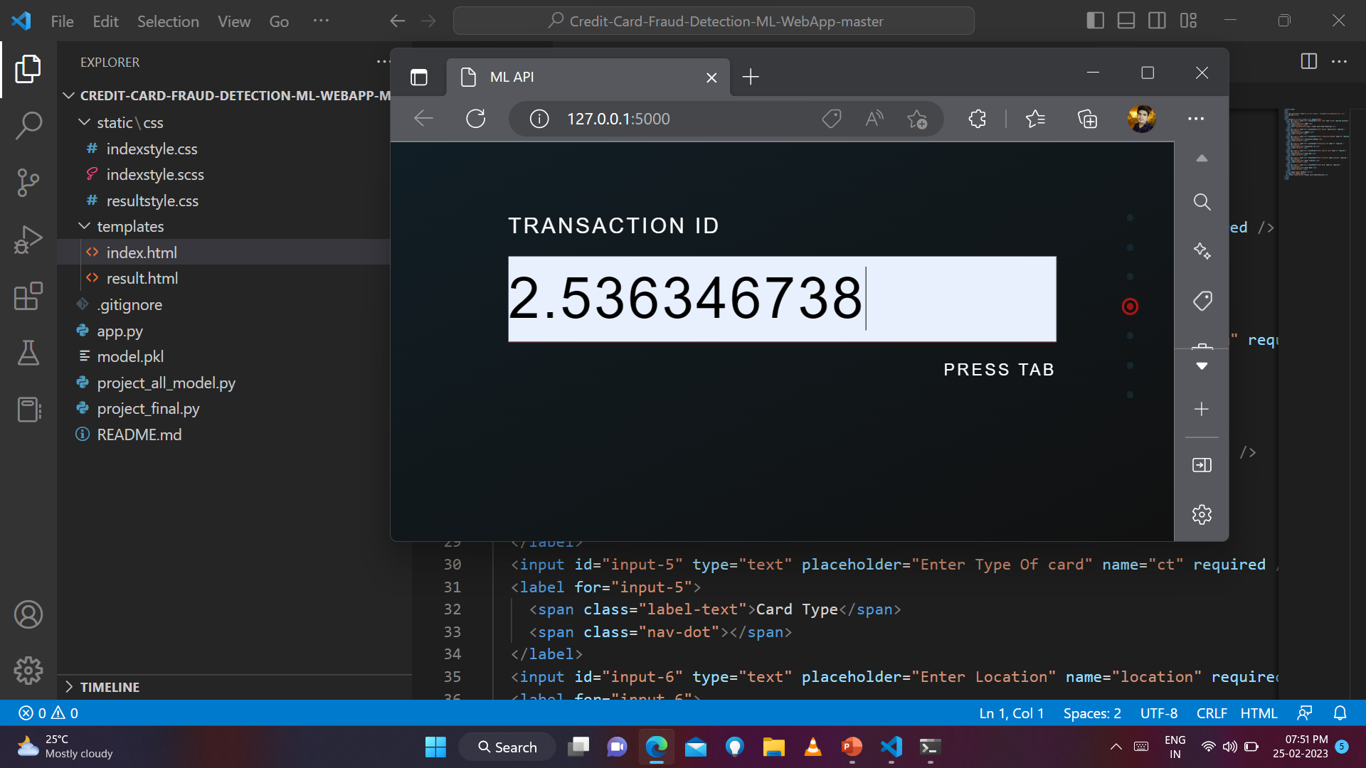

Slide 35


Slide 36


Slide 37


Slide 38
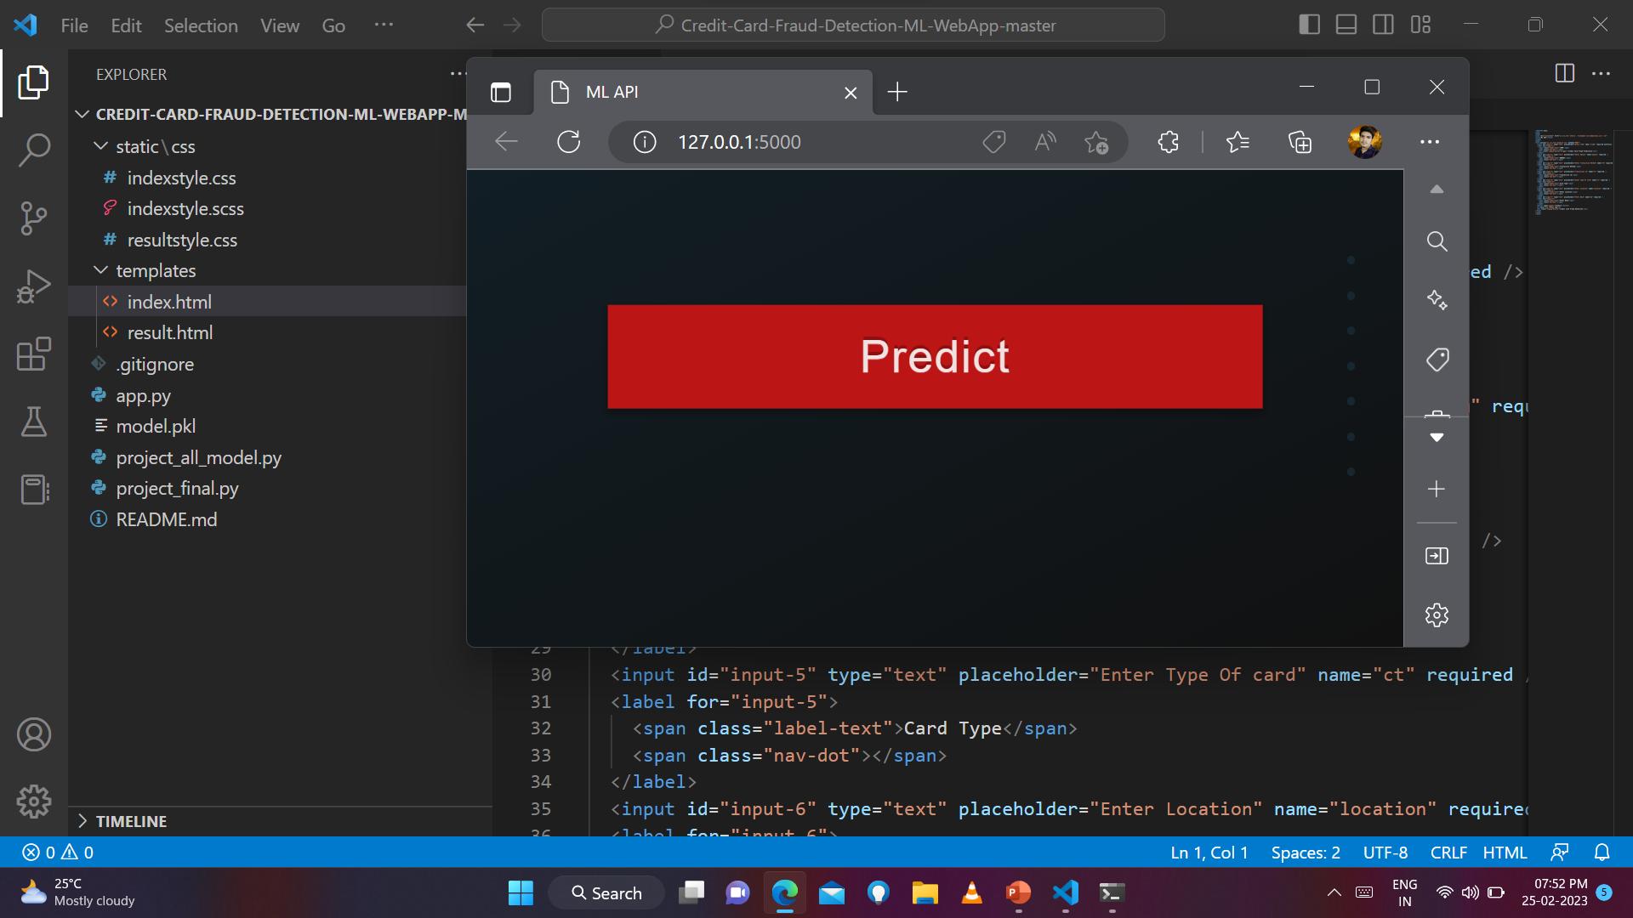

Slide 39
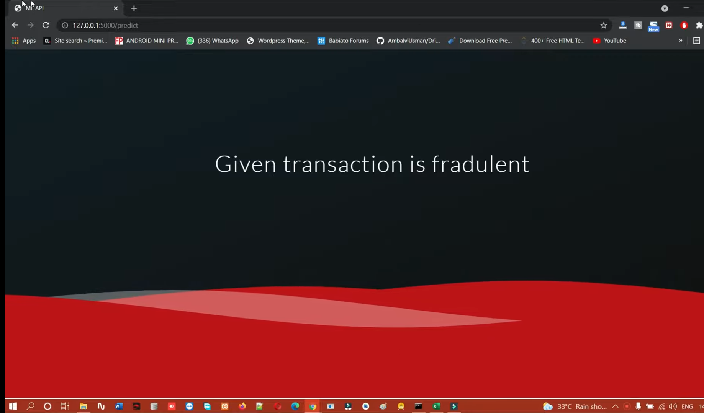
Result Phase:

Slide 40
Conclusion:-
Hence, we have acquired the result of an accurate value of credit card fraud detection i.e. 0.9994802867383512 (99.93%) using a random forest algorithm with new enhancements. In comparison to existing modules, this proposed module is applicable for the larger dataset and provides more accurate results. The Random forest algorithm will provide better performance with many training data, but speed during testing and application will still suffer. Usage of more pre-processing techniques would also assist.

Slide 41
References:-
https://www.kaggle.com/datasets/mlg-ulb/creditcardfraud
https://ieeexplore.ieee.org/document/9432308

Slide 42


